Slide 1
Routing I 🫂
Discussion 3
CS 168, Summer 2025 @ UC Berkeley
Slides credit: Sylvia Ratnasamy, Rob Shakir, Peyrin Kao, Iuniana Oprescu
Notes:
Slides template credit: Josh Hug, Lisa Yan

Slide 2
Logistics
Project 1B: Traceroute Error Handling
  Deadline: Thursday, July 3rd
Still somewhat far ahead: Midterm on July 22nd, 7-9pm (put it in your calendar)!

Slide 3
Distance-Vector Algorithm Sketch
Distance-Vector Correctness
Algorithm Sketch
Rule 1: Bellman-Ford Updates
Rule 2: Updates From Next-Hop
Rule 3: Resending and Expiring
Distance-Vector Enhancements
Rule 4: Poison Expired Routes
Rule 5A: Split Horizon
Rule 5B: Poison Reverse
Rule 6: Count To Infinity
Eventful Updates
Notes:
DV lecture last Wednesday, Lecture 5
DV good for small environment; need LS for enterprise scale

Slide 4
Distance-Vector Algorithm Sketch – Routing vs. Forwarding
Routing announcements ("I can reach A") propagated outward, away from A.
When forwarding packets toward A, packets travel inward, toward A.
One-line algorithm: If you hear about a path to a destination, tell all your neighbors!
R8
R4
R9
R2
R10
R5
R11
A
R1
R12
R6
R13
R3
R14
R7
R15
Notes:
To start out, every router’s forwarding table is empty. Our goal is to fill in the forwarding tables of every router, such that packets can be routed from anywhere to the destination, A.

Slide 5
Distance-Vector Algorithm Sketch – Multiple Destinations
What if there are multiple destinations?
Run the same path propagation algorithm, once per destination.
Routers use forwarding tables to keep track of the next-hop of each destination.
We'll focus on a single destination for simplicity.
But the protocol can extend to multiple destinations.
Notes:
multiple hosts on the network, e.g. A and B are both on the network — need to propagate information about both

Slide 6
Rule 1: Bellman-Ford Updates
Distance-Vector Correctness
Algorithm Sketch
Rule 1: Bellman-Ford Updates
Rule 2: Updates From Next-Hop
Rule 3: Resending and Expiring
Distance-Vector Enhancements
Rule 4: Poison Expired Routes
Rule 5A: Split Horizon
Rule 5B: Poison Reverse
Rule 6: Count To Infinity
Eventful Updates
Notes:
DV ~ distributed version of BF

Slide 7
Multiple Paths Advertised
What if you hear about multiple paths to a single destination?
Accept the shorter path.
A is 3 away from me.
R2
R3
I prefer what R4 is offering.
A
R1
R5
A this way
R4
A is 2 away from me.
Notes:
Reminder: trying to find shortest path to A

Slide 8
Multiple Paths Advertised
You might not hear about both paths simultaneously.
In the forwarding table, record the best-known cost to a destination.
If your table doesn't have a path to a destination, accept any path you hear about.
A is 3 away from me.
R2
R3
R5's Table
To: | Via: | Cost:
A | R3 | 4
A
R1
R5
R4
Notes:
cost is how much it takes from current router to reach the destination

Slide 9
Multiple Paths Advertised
You might not hear about both paths simultaneously.
In the forwarding table, record the best-known cost to a destination.
If your table doesn't have a path to a destination, accept any path you hear about.
If you hear about a better path later, update the table (next-hop and cost).
I like this new path better. I'll abandon the old one.
R2
R3
R5's Table
To: | Via: | Cost:
A | R3 R4 | 4 3
A
R1
R5
R4
A is 2 away from me.

Slide 10
The Distance-Vector Algorithm So Far
For each destination:
If you hear about a path to that destination, update table if:
  The destination isn't in the table.
  The advertised cost is better than best-known cost.
Then, tell all your neighbors.

Slide 11
Unequal Costs
Not all link costs are 1.
When a neighbor advertises a path, the cost via that path is the sum of:
  Link cost from you to the neighbor.
  Cost from neighbor to destination (as advertised by neighbor).
A is 5 away from me.
R1
1
R3
10
R3's Table
To: | Via: | Cost:
A | R1 | 1+5 = 6
R2

Slide 12
Unequal Costs
Not all link costs are 1.
When a neighbor advertises a path, the cost via that path is the sum of:
  Link cost from you to the neighbor.
  Cost from neighbor to destination (as advertised by neighbor).
This path actually costs 10+3=13. I'll keep using the cost 6 path and reject this.
R1
1
R3
10
R3's Table
To: | Via: | Cost:
A | R1 | 1+5 = 6
R2
A is 3 away from me.

Slide 13
The Distance-Vector Algorithm So Far
For each destination:
If you hear about a path to that destination, update table if:
  The destination isn't in the table.
  Advertised cost + link cost to neighbor < best-known cost. (#1)
Then, tell all your neighbors.

Slide 14
Distributed Bellman-Ford Algorithm
Careful viewers might have noticed this operation looks familiar.
"If cost to neighbor + cost from neighbor to destination < best-known cost,
accept update."
This is the relaxation operation in Dijkstra's shortest path algorithm!
Bellman-Ford is another relaxation-based shortest path algorithm.
Relax every edge repeatedly until we get shortest paths.
Unlike Dijkstra's, does not require relaxing the edges in any specific order.
Distance-vector algorithms are a distributed, asynchronous version of Bellman-Ford.
Distributed: Each router relaxes its own links. No global mastermind.
Asynchronous: Nobody is syncing when the routers do relaxations.

Slide 15
Rule 2: Updates from Next-Hop
Distance-Vector Correctness
Algorithm Sketch
Rule 1: Bellman-Ford Updates
Rule 2: Updates From Next-Hop
Rule 3: Resending and Expiring
Distance-Vector Enhancements
Rule 4: Poison Expired Routes
Rule 5A: Split Horizon
Rule 5B: Poison Reverse
Rule 6: Count To Infinity
Eventful Updates

Slide 16
Updates From the Current Next-Hop
Recall our routing challenges: Topology can change.
So far: We update if we get a better path (or if we didn't have a path before).
Fix: If our current next hop sends us an announcement, accept it,
even if the path is worse.
This lets the next-hop notify us if the topology changed.
Notes:
If we hear an announcement from the next-hop router (the router with the best-known path that we were forwarding packets to), we should treat that announcement as an update, and edit our forwarding table.

Slide 17
Convergence
If the network never changes:
After running this protocol for some time, it will converge.
Everyone's forwarding table has the least-cost next hop.
All future announcements will be rejected.
If a change happens (e.g. a link goes down):
Some new announcements are sent.
Some forwarding tables are updated.
Eventually, we converge again to the new routing state.
The network topology is constantly changing, so routers run the protocol indefinitely.
Steady-state occurs when the network has converged.
In steady-state, everything stays the same until the next topology change.

Slide 18
The Distance-Vector Algorithm So Far
For each destination:
If you hear an advertisement, update table if:
  The destination isn't in the table.
  Advertised cost + link cost to neighbor < best-known cost. (#1)
  The advertisement is from current next-hop. (#2)
Then, advertise to all your neighbors.

Slide 19
Rule 3: Resending and Expiring
Distance-Vector Correctness
Algorithm Sketch
Rule 1: Bellman-Ford Updates
Rule 2: Updates From Next-Hop
Rule 3: Resending and Expiring
Distance-Vector Enhancements
Rule 4: Poison Expired Routes
Rule 5A: Split Horizon
Rule 5B: Poison Reverse
Rule 6: Count To Infinity
Eventful Updates

Slide 20
The Distance-Vector Algorithm So Far
For each destination:
If you hear an advertisement, update table if:
  The destination isn't in the table.
  Advertised cost + link cost to neighbor < best-known cost. (#1)
  The advertisement is from current next-hop. (#2)
Advertise to all your neighbors when the table updates, and periodically. (#3)

Slide 21
Handling Failures
Recall our routing challenges: Links and routers can fail.
Solution: Each route has a finite time to live (TTL).
Periodic advertisements help us confirm that a route still exists.
  When we get an advertisement, reset ("recharge") the TTL.
If a link goes down, we stop getting periodic updates, and the TTL will expire.
  If the TTL expires, delete the entry from the table.
Notes:
Fail = may not be able to notify about failure

Slide 22
Timers
Routers maintain multiple timers:
Advertisement interval: How long before we advertise routes to neighbors.
  Usually one timer for all entries in the table.
TTL: How long before we expire a route.
  Each table entry has its own TTL.
Notes:
30 seconds is a common interval used in practice.

Slide 23
The Distance-Vector Algorithm So Far
For each destination:
If you hear an advertisement, update table and reset TTL if:
  The destination isn't in the table.
  Advertised cost + link cost to neighbor < best-known cost. (#1)
  The advertisement is from current next-hop. (#2)
Advertise to all your neighbors when the table updates, and periodically. (#3)
If a table entry expires, delete it. (#3)
This is a mostly-functional protocol now.
Let's add some optimizations for faster convergence.

Slide 24
Rule 4: Poison Expired Routes
Distance-Vector Correctness
Algorithm Sketch
Rule 1: Bellman-Ford Updates
Rule 2: Updates From Next-Hop
Rule 3: Resending and Expiring
Distance-Vector Enhancements
Rule 4: Poison Expired Routes
Rule 5A: Split Horizon
Rule 5B: Poison Reverse
Rule 6: Count To Infinity
Eventful Updates
Notes:
now that we have basic functionality, we want to make the protocol more robust + efficient

Slide 25
Poison for Fast Route Expiry
Key problem: When something fails, nobody's reporting it.
Solution: Poison ☠️.
Explicitly advertise that a path is busted.
A path with cost infinity represents a busted path.
This path propagates just like any other path.
  Routers accept the poison path to invalidate the route.
Can be much faster than waiting for timeouts!

Slide 26
Accepting and Advertising Poison
When you get a poison advertisement from the current next-hop:
Accept it, even if you have a better path.
  Because the next-hop is telling you that the route no longer exists.
  Similar to Rule #2: accept worse paths from current next-hop.
When you update the table with a poison route:
Reset the TTL, just like any other table update.
Advertise the poison to your neighbors, so they also know about the busted route.
Don't forward packets along a poisoned route.
To: | Via: | Cost:
A | R1 | ∞
Don't forward to R1.

Slide 27
The Distance-Vector Algorithm So Far
For each destination:
If you hear an advertisement, update table and reset TTL if:
  The destination isn't in the table.
  Advertised cost + link cost to neighbor < best-known cost. (#1)
  The advertisement is from current next-hop. (#2)
  Includes poison advertisements. (#4)
Advertise to all your neighbors when the table updates, and periodically. (#3)
If a table entry expires, make the entry poison and advertise it. (#3, #4)

Slide 28
Rule 5A/5B:
Split Horizon / Poison Reverse
Distance-Vector Correctness
Algorithm Sketch
Rule 1: Bellman-Ford Updates
Rule 2: Updates From Next-Hop
Rule 3: Resending and Expiring
Distance-Vector Enhancements
Rule 4: Poison Expired Routes
Rule 5A: Split Horizon
Rule 5B: Poison Reverse
Rule 6: Count To Infinity
Eventful Updates

Slide 29
Split Horizon / Poison Reverse – The Problem
The problem: When I give someone a path, they advertise it back to me.
Path goes from me → them → me.
Path with extra loop is always longer, so I'd never accept.
But if I lost my earlier routes, I might accept.
I might not realize the path is going through me.

Slide 30
Poison Reverse vs. Split Horizon
Split Horizon:
Poison Reverse:
I can reach A.
I can reach A.
R1
R2
R1
R2
I can reach A.
I cannot reach A.
I can reach A.
R1
R2
R1
R2
Don't advertise anything back to R1.
Explicitly advertise poison back to R1 (infinity).
Notes:
Only choose one of these two choices

Slide 31
Poison Reverse vs. Split Horizon
Suppose we end up with a routing loop somehow.
Split horizon: No poison is sent.
Loop stays until the routes expire.
I got this route from R3, so don't send it to R3.
I got this route from R2, so don't send it to R2.
R2
R3
R2's Table
To: | Via: | Cost:
A | R3 | 4
R3's Table
To: | Via: | Cost:
A | R2 | 3

Slide 32
Poison Reverse vs. Split Horizon
Suppose we end up with a routing loop somehow.
Poison reverse: R3 explicitly sends poison back to R2.
Loop is immediately eliminated!
Faster than split horizon.
I'm R3, and A is ∞ away from me.
R3 is my next-hop, so I accept.
I got this route from R2, so send poison to R2.
R2
R3
R2's Table
To: | Via: | Cost:
A | R3 | 4
R2's Table
To: | Via: | Cost:
A | R3 | ∞
R3's Table
To: | Via: | Cost:
A | R2 | 3

Slide 33
The Distance-Vector Algorithm So Far
For each destination:
If you hear an advertisement, update table and reset TTL if:
  The destination isn't in the table.
  Advertised cost + link cost to neighbor < best-known cost. (#1)
  The advertisement is from current next-hop. (#2)
  Includes poison advertisements. (#4)
Advertise to all your neighbors when the table updates, and periodically. (#3)
  But don't advertise back to the next-hop. (#5A)
  ...Or, advertise poison back to the next-hop. (#5B)
If a table entry expires, make the entry poison and advertise it. (#3, #4)

Slide 34
Rule 6: Count to Infinity
Distance-Vector Correctness
Algorithm Sketch
Rule 1: Bellman-Ford Updates
Rule 2: Updates From Next-Hop
Rule 3: Resending and Expiring
Distance-Vector Enhancements
Rule 4: Poison Expired Routes
Rule 5A: Split Horizon
Rule 5B: Poison Reverse
Rule 6: Count To Infinity
Eventful Updates

Slide 35
Count to Infinity – The Problem
Split horizon (or poison reverse) helps us avoid length-2 loops.
R1 forwards to R2.
R2 forwards to R1.
But we can still get routing loops with 3 or more routers.

Slide 36
Count to Infinity – The Problem
Suppose the tables reach steady-state.
R1's Table
To: | Via: | Cost:
A | R3 | 2
R1
R3's Table
To: | Via: | Cost:
A | Direct | 1
A
R3
R2's Table
To: | Via: | Cost:
A | R3 | 2
R2

Slide 37
Count to Infinity – The Problem
Link goes down! A now unreachable.
R3 updates table and sends poison.
Poison reaches R2, but not R1!
I'm R3, and A is
∞ away from me.
R1's Table
To: | Via: | Cost:
A | R3 | 2
Dropped!
R1
R3's Table
To: | Via: | Cost:
A | Direct | 1
R3's Table
To: | Via: | Cost:
A | Direct | ∞
A
R3
R2's Table
To: | Via: | Cost:
A | R3 | 2
R2's Table
To: | Via: | Cost:
A | R3 | ∞
I'm R3, and A is
∞ away from me.
R2

Slide 38
Count to Infinity – The Problem
At this point, R3 and R2 know A is unreachable.
But R1 still thinks there's a path to A!
R1's Table
To: | Via: | Cost:
A | R3 | 2
R1
R3's Table
To: | Via: | Cost:
A | Direct | ∞
A
R3
R2's Table
To: | Via: | Cost:
A | R3 | ∞
R2

Slide 39
Count to Infinity – The Problem
R1 announces it can reach A.
Split horizon: R1's path came from R3, so don't tell R3.
R1's Table
To: | Via: | Cost:
A | R3 | 2
R1
R3's Table
To: | Via: | Cost:
A | Direct | ∞
A
R3
I'm R1, and A is
2 away from me.
R2's Table
To: | Via: | Cost:
A | R3 | ∞
R2's Table
To: | Via: | Cost:
A | R1 | 3
R2

Slide 40
Count to Infinity – The Problem
R2 announces it can reach A.
Split horizon: R2's path came from R1, so don't tell R1.
R1's Table
To: | Via: | Cost:
A | R3 | 2
R1
R3's Table
To: | Via: | Cost:
A | Direct | ∞
R3's Table
To: | Via: | Cost:
A | R2 | 4
A
R3
R2's Table
To: | Via: | Cost:
A | R1 | 3
I'm R2, and A is
3 away from me.
R2

Slide 41
Count to Infinity – The Problem
R3 announces it can reach A.
Split horizon: R3's path came from R2, so don't tell R2.
R1's Table
To: | Via: | Cost:
A | R3 | 2
I'm R3, and A is
4 away from me.
R1's Table
To: | Via: | Cost:
A | R3 | 5
R1
R3's Table
To: | Via: | Cost:
A | R2 | 4
A
R3
R2's Table
To: | Via: | Cost:
A | R1 | 3
R2

Slide 42
Count to Infinity – The Problem
We keep advertising in a cycle, and costs keep increasing!
Split horizon can't save us.
R1's Table
To: | Via: | Cost:
A | R3 | 5
R1
R3's Table
To: | Via: | Cost:
A | R2 | 4
A
R3
I'm R1, and A is
5 away from me.
R2's Table
To: | Via: | Cost:
A | R1 | 3
R2's Table
To: | Via: | Cost:
A | R1 | 6
R2

Slide 43
Count to Infinity – The Problem
We keep advertising in a cycle, and costs keep increasing!
Split horizon can't save us.
R1's Table
To: | Via: | Cost:
A | R3 | 5
R1
R3's Table
To: | Via: | Cost:
A | R2 | 4
R3's Table
To: | Via: | Cost:
A | R2 | 7
A
R3
R2's Table
To: | Via: | Cost:
A | R1 | 6
I'm R2, and A is
6 away from me.
R2

Slide 44
Count to Infinity – The Problem
We keep advertising in a cycle, and costs keep increasing!
Split horizon can't save us.
R1's Table
To: | Via: | Cost:
A | R3 | 5
I'm R3, and A is
7 away from me.
R1's Table
To: | Via: | Cost:
A | R3 | 8
R1
R3's Table
To: | Via: | Cost:
A | R2 | 7
A
R3
R2's Table
To: | Via: | Cost:
A | R1 | 6
R2

Slide 45
Count to Infinity – The Problem
We keep advertising in a cycle, and costs keep increasing!
Split horizon can't save us.
R1's Table
To: | Via: | Cost:
A | R3 | 8
R1
R3's Table
To: | Via: | Cost:
A | R2 | 7
A
R3
I'm R1, and A is
8 away from me.
R2's Table
To: | Via: | Cost:
A | R1 | 6
R2's Table
To: | Via: | Cost:
A | R1 | 9
R2

Slide 46
Count to Infinity – The Problem
We keep advertising in a cycle, and costs keep increasing!
Split horizon can't save us.
R1's Table
To: | Via: | Cost:
A | R3 | 8
R1
R3's Table
To: | Via: | Cost:
A | R2 | 7
R3's Table
To: | Via: | Cost:
A | R2 | 10
A
R3
R2's Table
To: | Via: | Cost:
A | R1 | 9
I'm R2, and A is
9 away from me.
R2

Slide 47
Count to Infinity – The Problem
We keep advertising in a cycle, and costs keep increasing!
Split horizon can't save us.
R1's Table
To: | Via: | Cost:
A | R3 | 8
I'm R3, and A is
10 away from me.
R1's Table
To: | Via: | Cost:
A | R3 | 11
R1
R3's Table
To: | Via: | Cost:
A | R2 | 10
A
R3
R2's Table
To: | Via: | Cost:
A | R1 | 9
R2

Slide 48
Count to Infinity – Solution
Solution: Enforce a maximum cost.
15 is a common choice.
All numbers ≥ 16 are considered infinity.
Result:
Loop will stop when all costs reach 16.
Busted path will expire, or get replaced by another non-infinite-cost path.

Slide 49
The Distance-Vector Algorithm So Far
For each destination:
If you hear an advertisement, update table and reset TTL if:
  The destination isn't in the table.
  Advertised cost + link cost to neighbor < best-known cost. (#1)
  The advertisement is from current next-hop. (#2)
  Includes poison advertisements. (#4)
Advertise to all your neighbors when the table updates, and periodically. (#3)
  But don't advertise back to the next-hop. (#5A)
  ...Or, advertise poison back to the next-hop. (#5B)
  Any cost ≥ 16 is advertised as ∞. (#6)
If a table entry expires, make the entry poison and advertise it. (#3, #4)

Slide 50
Eventful Updates
Distance-Vector Correctness
Algorithm Sketch
Rule 1: Bellman-Ford Updates
Rule 2: Updates From Next-Hop
Rule 3: Resending and Expiring
Distance-Vector Enhancements
Rule 4: Poison Expired Routes
Rule 5A: Split Horizon
Rule 5B: Poison Reverse
Rule 6: Count To Infinity
Eventful Updates

Slide 51
Eventful Updates
When do we send advertisements?
When the table changes (triggered updates).
  When we accept a new advertisement.
  When a new link is added. (Add static routes and advertise them.)
  When a link goes down. (Poison routes and advertise poison.)
Periodically (once every "advertisement interval").
When a table entry expires.
Triggered updates are an optimization.
Instead of advertising when the table changes, we could just wait for the interval. Protocol is still correct.
Triggered updates help us converge faster.

Slide 52
Our Completed Distance-Vector Algorithm
For each destination:
If you hear an advertisement, update table and reset TTL if:
  The destination isn't in the table.
  Advertised cost + link cost to neighbor < best-known cost. (#1)
  The advertisement is from current next-hop. (#2)
  Includes poison advertisements. (#4)
Advertise to all your neighbors when the table updates, and periodically. (#3)
  But don't advertise back to the next-hop. (#5A)
  ...Or, advertise poison back to the next-hop. (#5B)
  Any cost ≥ 16 is advertised as ∞. (#6)
If a table entry expires, make the entry poison and advertise it. (#3, #4)

Slide 53
Worksheet
Distance Vector
Split Horizon and Poison
Count to Infinity

Slide 54
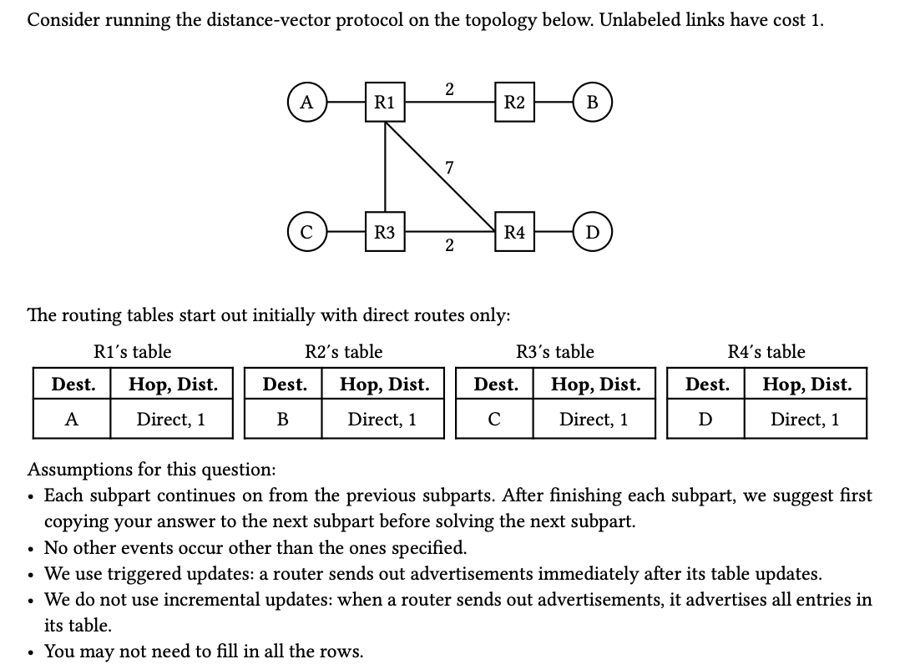
Question 1: Distance Vector

Slide 55
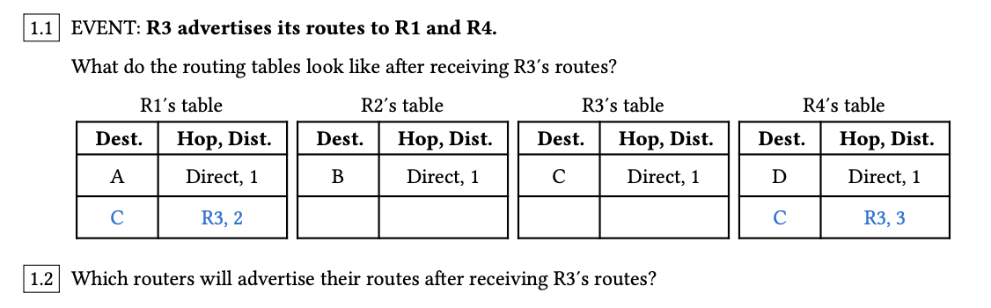

Question 1: Distance Vector

Slide 56
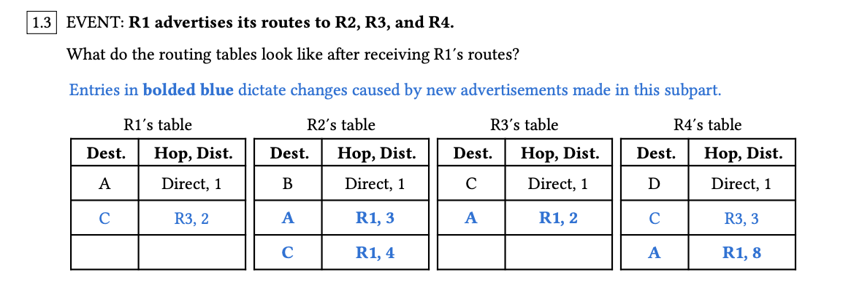
Question 1: Distance Vector

Slide 57
Question 1: Distance Vector

Slide 58
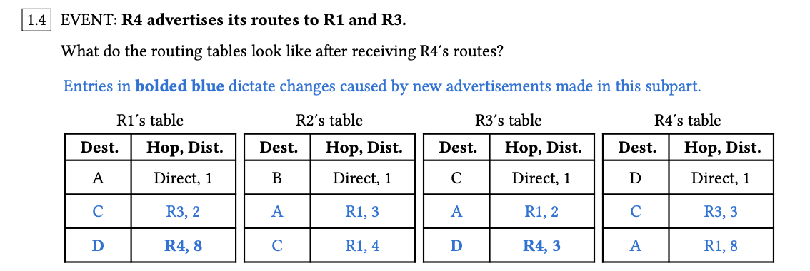
Question 1: Distance Vector

Slide 59
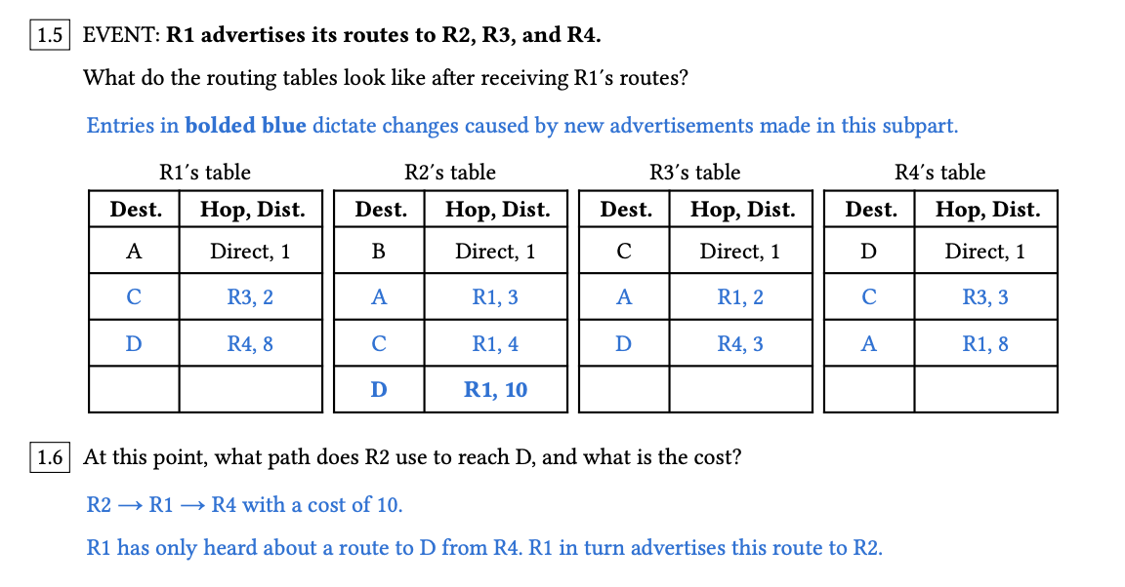
Question 1: Distance Vector

Slide 60
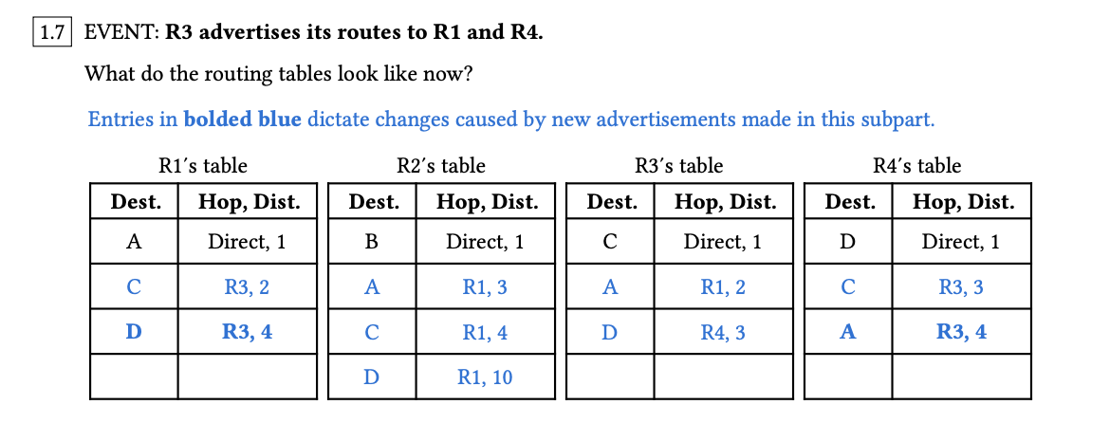
Question 1: Distance Vector

Slide 61
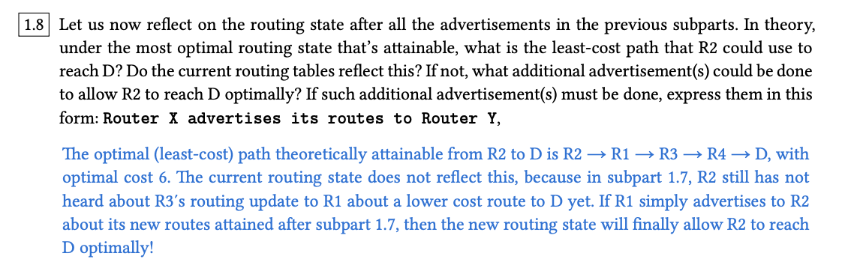
Question 1: Distance Vector

Slide 62
Worksheet
Distance Vector
Split Horizon and Poison
Count to Infinity

Slide 63
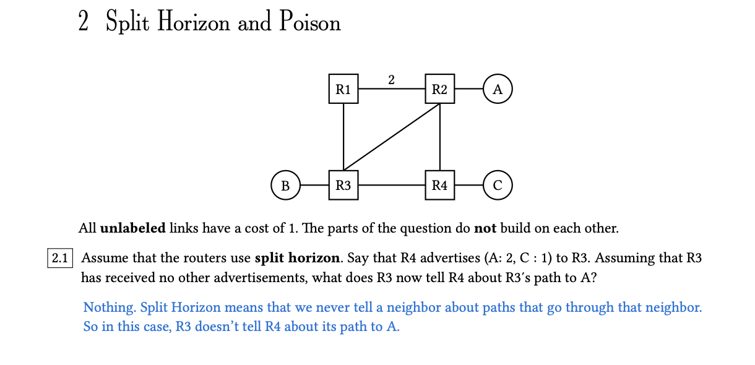
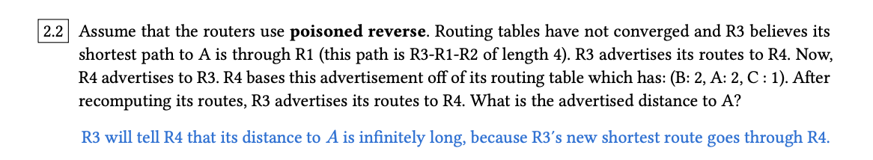
Question 2: Split Horizon and Poison

Slide 64
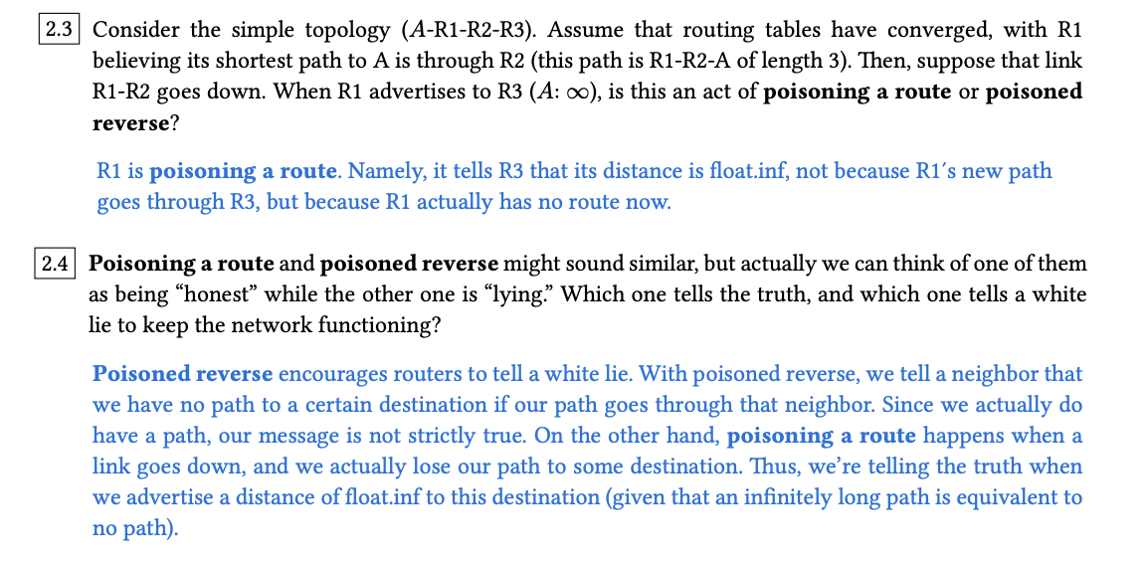
Question 2: Split Horizon and Poison

Slide 65
Worksheet
Distance Vector
Split Horizon and Poison
Count to Infinity

Slide 66
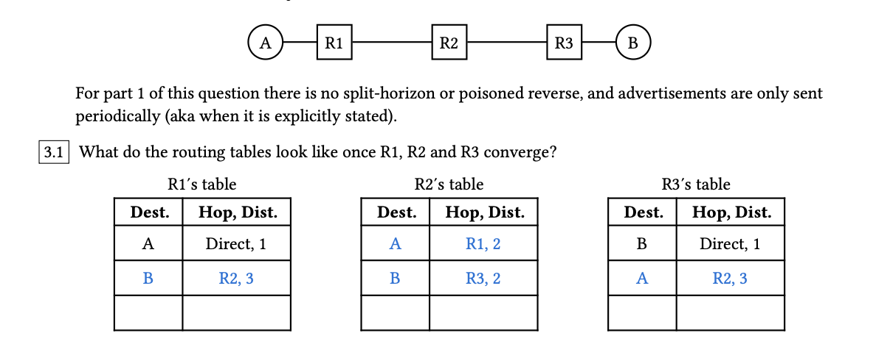

Question 3: Count to Infinity

Slide 67
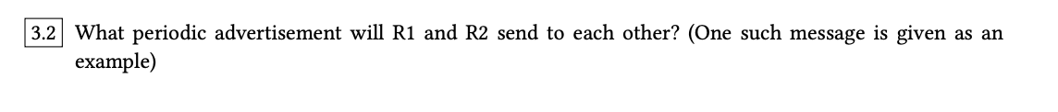
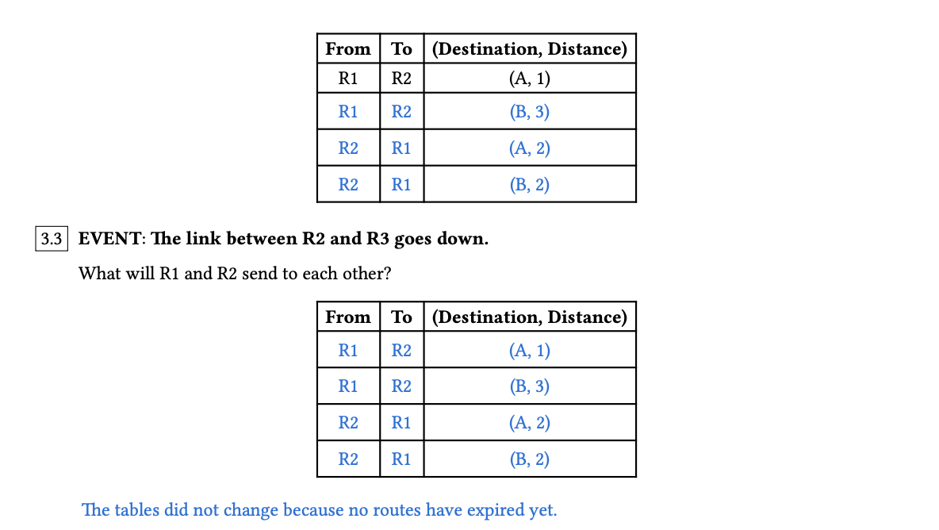
Question 3: Count to Infinity

Slide 68
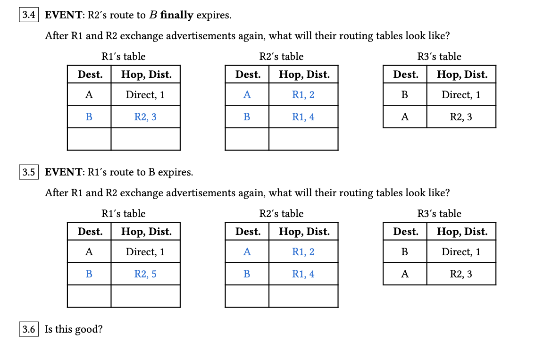
Question 3: Count to Infinity

Slide 69
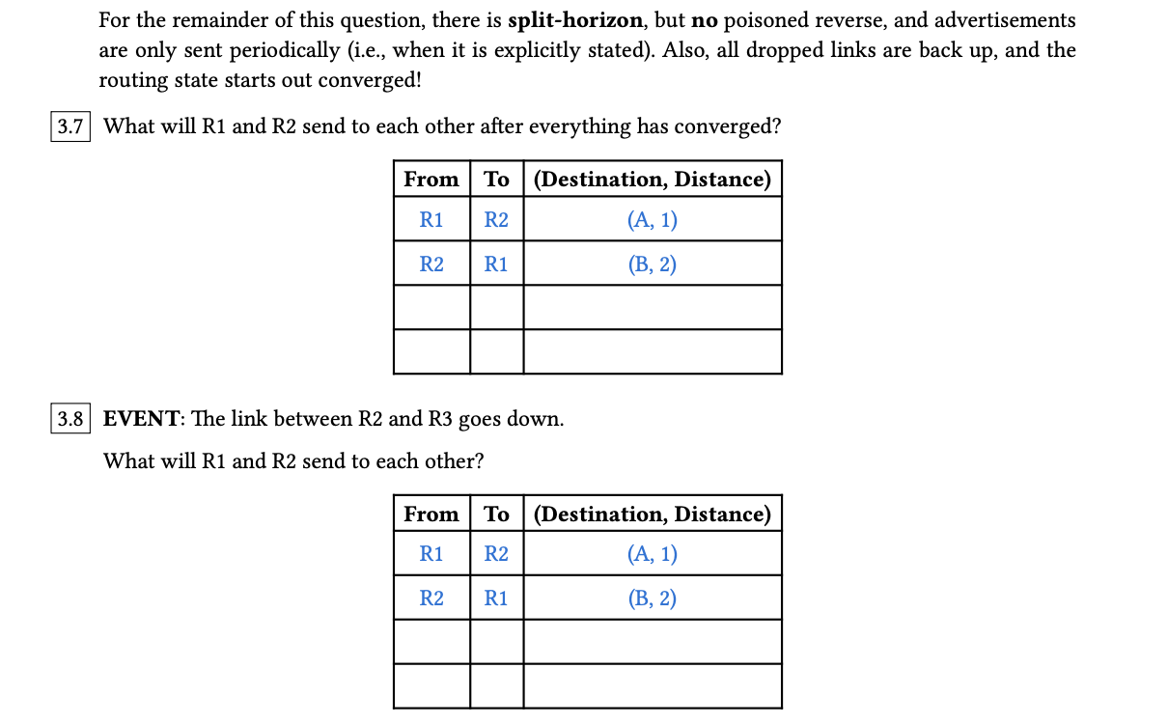
Question 3: Count to Infinity

Slide 70
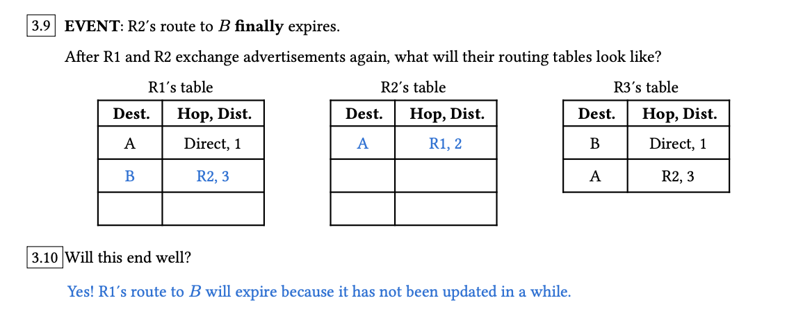
Question 3: Count to Infinity

Slide 71

Questions?
Feedback Form: https://tinyurl.com/cs168-su25-disc-feedback

